Slide 1


HUM 102 Report Writing Skills
Lecture 26

Slide 2

Previous Lecture
Basics of Resumé
Basics of CV
CV and Resumé Comparison
CV and Resumé Guidelines

Slide 3




Interview Skills
About Interview
Entrevue (French), Enterview (English)
Interaction of views
To see each other’s views
One-on-One conversation between a job applicant and employer/representatives of employer
An opportunity for employer to match applicant’s qualification and employer’s needs

Slide 4
Interview Skills
Interview Types [1/2]
Screening Interview: First meeting with employers, eliminating incompetent candidates, on-campus and job fair interviews
Follow-up Interview: Second interview, identifying finalists for a position after asking specific job related questions by several interviewers
Phone Interview: Alternative for screening and follow-up, used by an employer located distance away, evaluation based on responses, tone, enthusiasm, comfort and adaptability

Slide 5
Interview Skills
Interview Types [2/2]
Selection Interview: Final interview by supervisor/manager alongside others
Search Committee Interview: You are required to respond to questions from each person of a search committee (maintain eye contact)
Group Interview: You are interviewed as a group of several candidates together to evaluate group task, leadership, decision making, flexibility, adaptability, etc.
Breakfast/Lunch/Dinner Interview: Q/A session with the people working in your prospective organization

Slide 6
Interview Skills
Interview Styles
Directive: You are required to provide the answers of raised questions
Non-Directive: You direct the interview by controlling discussion
Stress/Confrontational: To unsettle you, to evaluate how you respond with a challenging, creative answer
Behavioral: To seek responses that may give insights to personality traits and critical skills. Focus is on leadership ability, intellectual competence, personal/team skills, adjustment/flexibility, motivation, communication/administrative/technical skills

Slide 7
Interview Skills
Most Common Interview Mistakes [1/3]
Arriving late
Arriving too early
Wrong dressing
Dressing in a rush
Smoking
Chewing gum
No Idea about organization/job description
No preparation

Slide 8
Interview Skills
Most Common Interview Mistakes [2/3]
Not knowing your strength and weaknesses (SWOT Analysis)
Asking too many questions or no questions at all
Inquiring about benefits too early
Revealing your expected salary package
Getting impatient on some inappropriate question
Criticizing your old boss

Slide 9
Interview Skills
Most Common Interview Mistakes [3/3]
Lack of energy/passion
Weak handshake
Glancing at your watch time and again
Playing the role of a savior for the company/organization

Slide 10
Interview Skills
Planning [1/2]
Self-Assessment: Reviewing your skills/abilities, background, values, experience, education, training, and career goals
Understanding Field of Interest: Knowing the field, industries, industry trends, major competitors, future projections, characteristics of working individuals
Employer’s Information: Knowledge about products, services, location, previous and projected growth, future prospects

Slide 11
Interview Skills
Planning [2/2]
Awareness of Job Description: To prove that you know you are fit for the post
Prior Knowledge of Interview Format
Preparing for the Anticipated Questions: Mock interviews
Making a List of Questions: In case you are asked to raise questions, shows your interest in the company

Slide 12
Interview Skills
Preparation
In case of your very first interview, you may write out the answers of anticipated questions
Practice saying your responses out loud (in front of a mirror); becoming aware of your facial expressions and gestures
Film or record your responses
Self-assessment and ask for feedback on content, its organization and delivery

Slide 13
Interview Skills
General Instructions [1/4]
Arriving Early: To avoid traffic problems
Arriving Prepared: With resume, references and academic transcripts organized in a folio
Giving a thoughtful and complete answer: avoid one word answers, ask for clarification in confusion, pause to consider answering is acceptable
Making a Good First Impression: with appearance, behavior and attitude

Slide 14
Interview Skills
General Instructions [2/4]
Take care of your appearance
Dress professionally instead of being overdressed with flashy colors or styles
Use make-up moderately
Making sure that hair/mustache are well trimmed
Don’t overdo use of jewelry
Avoiding strong perfumes, colognes, aftershaves, etc.
Shiny shoes/ cleaned fingernails/ cleaned glasses

Slide 15
Interview Skills
General Instructions [3/4]
Take care of your behavior
Firm handshake
Maintain eye contact
Smile and be friendly
Do not overextend the interview

Slide 16
Interview Skills
General Instructions [4/4]
Take care of your attitude
Project confidence and enthusiasm
Sincerity and commitment
Optimism

Slide 17
Interview Skills
Instructions for Specific Interview Types [1/4]
For a Screening/Video/Phone Interview
Schedule the interview at an ideal time (when you are fresh) and an ideal place (with quiet and good Wi-Fi)
Be prepared with a list of points (skills, accomplishments, questions to ask)
Keep a copy of your resume
Listen actively and avoid interrupting the interviewer
Speak clearly and slowly (not too slow)
Project enthusiasm in your voice

Slide 18
Interview Skills
Instructions for Specific Interview Types [2/4]
For Phone Interview:
If possible, stand up to revive energy
Smile at intervals to have its effects in your voice
Avoid filters (umm, err, uh) being more noticeable on the phone
Dress formally to have an interview mindset
Have the interviewer’s website open for reference

Slide 19
Interview Skills
Instructions for Specific Interview Types [3/4]
For Video Interview:
Look at the camera instead of the screen for eye contact with the interviewer
Dress like an in-person interview
Pick a place with a neutral background
Get used to technology by running a practice interview with a friend
Pay attention to body language

Slide 20
Interview Skills
Instructions for Specific Interview Types [4/4]
For Second Round Interview:
Review your first interview
Research the employer to gather more information
Try to find staff members working in the company (not part of the hiring committee)

Slide 21
Interview Skills
At the Interview
Turn off your cell phone
Be respectful to everyone
Do not put your belongings on the interview desk
Just remember that in case you receive a verbal offer, do not accept or reject it immediately without thinking

Slide 22
Interview Skills
Nature of Interview Questions
Traditional Questions: Experience, background, personal qualities
Behavioral Questions: Predicting Future behavior from discussing the past events and situations
Technical or Case Questions: Field-specific

Slide 23
Interview Skills
Traditional Questions [1/2]
Tell me about yourself.
Why are you interested in this position/industry/ organization?
What do you know about us?
Why should we hire you? What can you offer us?
Describe your ideal job.
What are your greatest strengths and weaknesses?
Tell me about an accomplishment that you are proud of.
What have you learned from your failures?
What motivates you to do good work?

Slide 24
Interview Skills
Traditional Questions [2/2]
How do you prefer to be supervised?
How would a former supervisor describe you?
How about your friends?
Why did you decide to attend XYZ university?
Why did you choose your major?
Which classes did you enjoy most/least and why?
What do you see yourself doing in five years?
Do you plan to return to school for further education?
What other positions are you interviewing for?

Slide 25
Interview Skills
Behavioral Questions [1/8]
Interpersonal Skills:
When working on a team project, have you ever dealt with a strong disagreement among team members or a team member who didn’t do their part? What did you do?
Tell me about the most difficult or frustrating individual that you’ve ever had to work with and how you approached the situation.
Tell me about a time when you had to be assertive.

Slide 26
Interview Skills
Behavioral Questions [2/8]
Communication Skills:
Tell me about a time when you had to present complex information. How did you get your point across?
Describe a time when you used persuasion to convince someone to see things your way.
Tell me about a time when you used written communication skills to convey an important point.

Slide 27
Interview Skills
Behavioral Questions [3/8]
Initiative:
Provide an example of when you had to go above and beyond the call of duty to get a job done.
Tell me about a project you initiated.

Slide 28
Interview Skills
Behavioral Questions [4/8]
Creativity/Innovation:
Describe a time when you provided a creative solution to a problem.
What is the most creative thing you have done?

Slide 29
Interview Skills
Behavioral Questions [5/8]
Leadership:
Tell me about a time when you influenced the outcome of a project by taking a leadership role.
Describe your leadership style and provide an example of a situation where you successfully led a group.
Provide an example that demonstrates your ability to motivate others.

Slide 30
Interview Skills
Behavioral Questions [6/8]
Planning and Organization:
Tell me about an important goal of yours. How did you reach it?
Describe a situation when you had many assignments or projects due at the same time. What steps did you take to finish them?
Provide an example of what you’ve done when your time schedule or plan was upset by unforeseen circumstances.

Slide 31
Interview Skills
Behavioral Questions [7/8]
Flexibility:
Describe a situation in which you overcame a “personality conflict” in order to get results.
Describe a time where you were faced with issues that tested your coping skills.
Describe a time when you received constructive criticism.

Slide 32
Interview Skills
Behavioral Questions [8/8]
Decision-Making:
Provide an example of when you had to make a difficult decision. How did you approach it? What kinds of criteria did you use?
Describe a time when you had to defend your decision.
Summarize a situation where you had to locate relevant information, define key issues, and determine the steps to get a desired result.

Slide 33
Interview Skills
Strategy for Behavioral Questions
STAR Formula:
Situation, Task: To accomplish
Action: which you took
Results: which you achieved (quantify where possible)
CAR Formula:
Context
Action
Results (quantified)

Slide 34
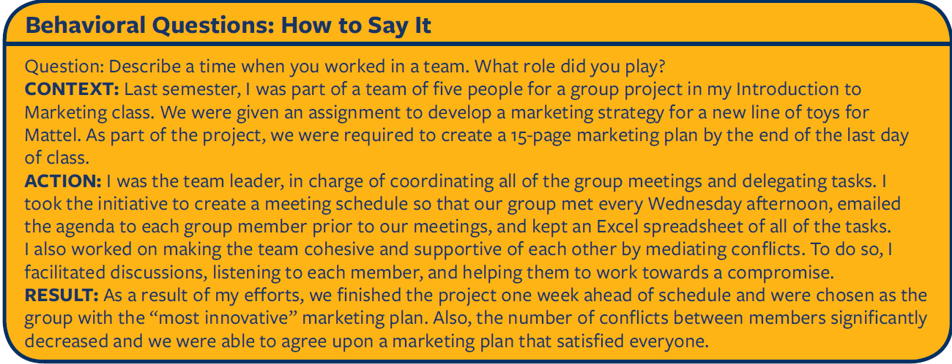
Interview Skills
Example of CAR Formula

Slide 35
Interview Skills
Technical Questions
Common in finance, accounting, consulting, engineering, computer science fields
Questions may be related with concepts learned from coursework, industry knowledge, specific skills
Practice and consult other workers and alumni

Slide 36
Interview Skills
Tricky Questions
Tell me about yourself (Reply keeping in view audience and purpose)
What are your greatest strengths and weaknesses? (Be honest and turn it into an opportunity)
What are your salary expectations? (Start with “I am sure you have a range in mind.” and then “What are you willing to offer?” instead of quantifying the answer immediately

Slide 37
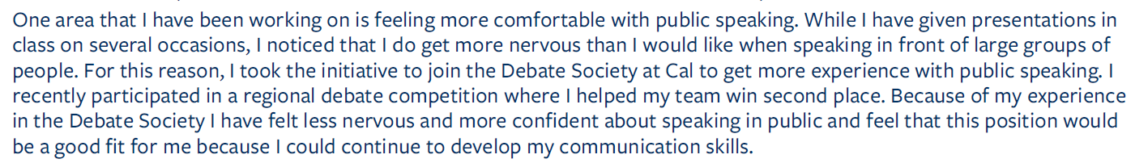
Interview Skills
Strength-Weakness Answer: A Sample

Slide 38
Interview Skills
Questions for Employer [1/2]
What kind of training do you offer to new employees?
When and how are employees evaluated?
What are the best/most difficult aspects of working in this group/organization?
What’s the biggest challenge facing this group/ organization right now?
How would you describe the culture of this organization?
What do you see as unique about your organization compared with your major competitors? What are your plans for expansion in terms of product lines, services, new branches, etc.?
How would you describe this organization’s management style? How are decisions made?

Slide 39
Interview Skills
Questions for Employer [2/2]
What are some typical first-year assignments?
How does this position fit into the overall organizational structure?
May I have your business card?
What are the next steps in the hiring process?

Slide 40
Interview Skills
After Interview
Write a Brief “Thank you note”: Reiterate your interest, state why you are ideal candidate
Evaluate the whole interview process
Follow-up Email: In case of silence from the employer, communicate with them after a wait of week or two to show your continued interest for the position

Slide 41
References
Berkeley University of California. (n.d.). Interviewing. Retrieved from https://career.berkeley.edu/sites/default/files/pdf/Guide/Interviewing.pdf
Saint Mary's University of Minnesota. (n.d.). Preparing for the Job Interview. Minnesota, US: Saint Mary's University

Slide 42
Conclusions
Basics of Interview
Interview Styles
Interview Types
Common Mistakes in Interviews
General Instructions for Interviews

